Slide 1
UNIVERSITY INSTITUTE OF ENGINEERING
Department of Computer Science & Engineering
Databases Management System
(23CSH-205/23ITH-205)
DR. GITANJALI
E16525
ASSISTANT PROFESSOR
CSE
DISCOVER . LEARN . EMPOWER

Slide 2
ABOUT COURSE
The main DBMS course, we learn about the structural formation of data, maintain data integrity, multitasking with concurrent access and recovery without occurring crashes, data structures, data models etc. and their working in which every organization is based.
At the end of the course, the students may understand the concepts of data structures, data models and design, construction of queries by using SQL, uses and applications of database design etc

Slide 3
COURSE OUTCOMES
CO No. | Title | BT Level
CO1 | Students will be able to understand the database system concepts and design databases for different applications. | Memorize
CO2 | Students will be able to identify different types of DDL, DML, DCL and TCL commands and their usage. | Understanding
CO3 | Students will be able to classifying Normalization, Dependencies and Denormalization along with their requirements. | Apply
CO4 | Students will be able to analyse and Compare Transaction Processing techniques and Recovery techniques. | Analyze
CO5 | Students will be able to evaluate database performance after implementing Triggers, procedures, packages, cursors and views. | Evaluate
Will be covered in this lecture

Slide 4
COURSE OBJECTIVES
This course will enable students to,
To have good understanding of database system concepts and design databases for different applications.
To learn how to use a DBMS and RDBMS.
To implement and understand different types of DDL, DML and DCL statements.
To understand transaction concepts related to databases and recovery/backup techniques required for the proper storage of data.

Slide 5
Topics covered
Data Models:
Relational Model, Network Model, Hierarchical Model, ER Model: Design, issues, Mapping constraints, ER diagram, Comparison of Models.

Slide 6
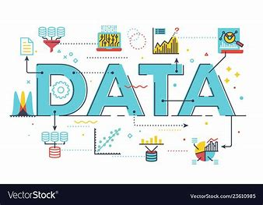
Data Models
A Data Model is a conceptual framework that determines how data is logically structured, stored, and manipulated in a database. It provides a way to define, organize, and relate data in a database. Data Models provide us with a transparent picture of data which helps us in creating an actual database.
Types of Data Models:
Conceptual Data Model (high-level, semantic)
Logical Data Model (low-level, internal)
Physical Data Model (representational)

Slide 7
Data Models
A Data Model is a conceptual framework that determines how data is logically structured, stored, and manipulated in a database. It provides a way to define, organize, and relate data in a database. Data Models provide us with a transparent picture of data which helps us in creating an actual database.
Types of Data Models:
Conceptual Data Model (high-level, semantic)
Logical Data Model (low-level, internal)
Physical Data Model (representational)

Slide 8

Categories of data models
Record Based Data Models
Some examples of Record-based data models are
Hierarchical
Network
Relational
Object based Data Models
Some examples of Object-based data models are
Entity Relationship Data Model
Object Oriented Data Model
Semantic Data Model
Functional Data Model

Slide 9
Hierarchical Model
Hierarchical Model:
This is one of the oldest models in a data model which was developed by IBM, in the 1950s. In a hierarchical model, data are viewed as a collection of tables, or we can say segments that form a hierarchical relation. In this, the data is organized into a tree-like structure where each record consists of one parent record and many children. Even if the segments are connected as a chain-like structure by logical associations, then the instant structure can be a fan structure with multiple branches.
Applications of hierarchical model :
Hierarchical models are generally used as semantic models in practice as many real-world occurrences of events are hierarchical in nature like biological structures, political, or social structures.
Hierarchical models are also commonly used as physical models because of the inherent hierarchical structure of the disk storage system like tracks, cylinders, etc.

Slide 10

Hierarchical Model
Advantages of the Hierarchical Data Model
Because of its tree form, it is easy to grasp.
Retrieving data in a one-to-many connection is efficient.
Disadvantages of the Hierarchical Data Model
Inflexibility in reorganizing data.
accessing complicated data structures may be challenging.
redundant data storage, which might cause anomalies and inconsistencies.

Slide 11
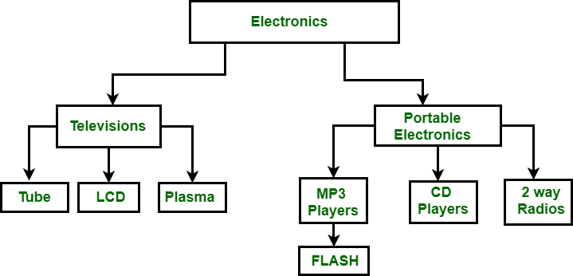
Hierarchical Model
Hierarchical Model

Slide 12
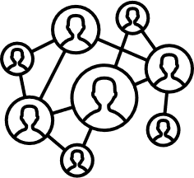
Network Models
What is Network Model?
This model was formalized by the Database Task group in the 1960s. This model is the generalization of the hierarchical model. This model can consist of multiple parent segments and these segments are grouped as levels but there exists a logical association between the segments belonging to any level. Mostly, there exists a many-to-many logical association between any of the two segments. We called graphs the logical associations between the segments. Therefore, this model replaces the hierarchical tree with a graph-like structure, and with that, there can more general connections among different nodes.

Slide 13

Network Models
Advantages of the Network Data Model
Because of its numerous parent ties, it is more adaptable than the hierarchical approach.
Ideal for managing intricate, many-to-many connections.
Disadvantages of the Network Data Model
Increased complexity in database design and management.
requires complex programming in order to manage and work with data.

Slide 14
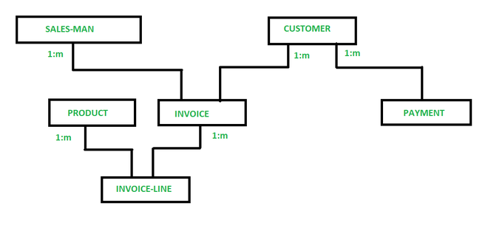
Network Models
Network model of Finance Department.

Slide 15
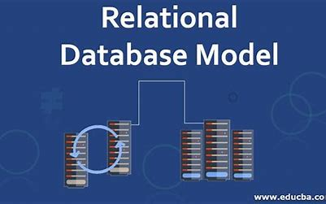
Relational Model
What is the Relational Model?
The relational model for database management is an approach to logically represent and manage the data stored in a database. This model organises the data into a collection of two-dimensional inter-related tables, also known as relations. Each relation is a collection of columns and rows, where the column represents the attributes of an entity and the rows (or tuples) represent the records.
The use of tables to store the data provided a straightforward, efficient, and flexible way to store and access structured information. Because of this simplicity, this data model provides easy data sorting and data access. Hence, it is used widely around the world for data storage and processing.

Slide 16
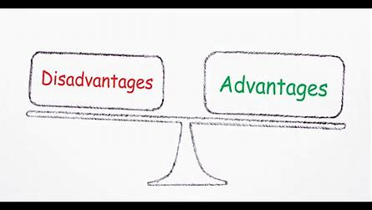
Relational Model
Advantages of the Relational Data Model
High data independence and flexibility.
offers robust and user-friendly querying features.
removes duplication by use of normalization.
Disadvantages of the Relational Data Model
For certain kinds of straightforward data retrieval tasks, they may not perform as well as hierarchical models.
demands a deeper comprehension of SQL and normalization principles.

Slide 17
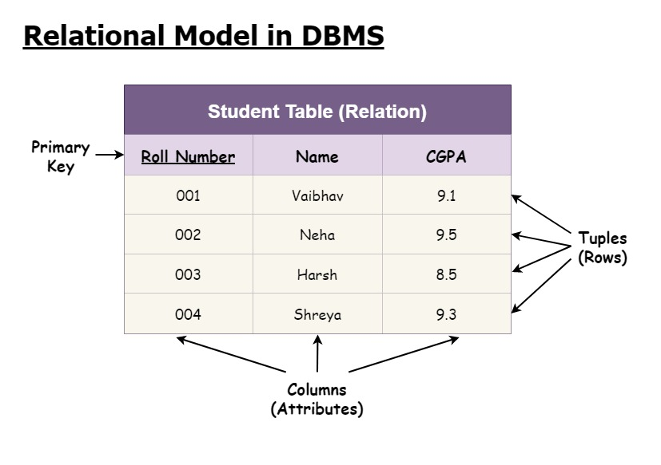
Relational Model
Relational Model

Slide 18
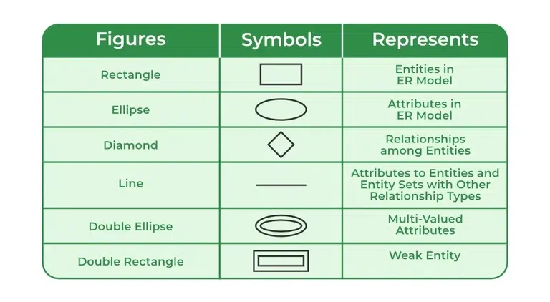
Entity Relationship Data Model
Entity Relationship Data Model
ER model is used to represent real life scenarios as entities. The properties of these entities are their attributes in the ER diagram and their connections are shown in the form of relationships. An ER model is generally considered as a top-down approach in data designing.
Use of ER Diagrams
Design databases during the conceptual and logical modeling stages.
Clarify system requirements with stakeholders.
Serve as a blueprint for developers and database administrators.

Slide 19
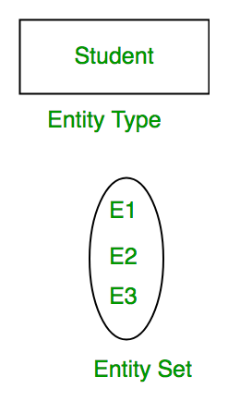
Entity Relationship Data Model
What is Entity?
An entity is a fundamental concept in data modeling, representing a real-world object, person, place, event, or concept that can be distinctly identified within a system. Entities are the building blocks of databases and are used to organize and store information systematically.
Examples of entities:
•Person: Employee, Student, Patient
•Place: Store, Building
•Object: Machine, product, and Car
•Event: Sale, Registration, Renewal
•Concept: Account, Course

Slide 20
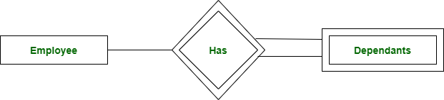
Entity Relationship Data Model
Types of Entity:
1. Strong Entity: A Strong Entity is an entity with a key Attribute. Strong Entity does not depend on other Entity in the Schema. It has a primary key, that helps in identifying it uniquely, and it is represented by a rectangle. These are called Strong Entity Types.
2. Weak Entity: An Entity type has a key attribute that uniquely identifies each entity in the entity set. But some entity type exists for which key attributes can’t be defined. These are called Weak Entity types .
Strong Entity and Weak Entity

Slide 21
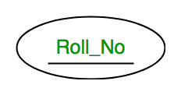
Entity Relationship Data Model
What is Attributes?
Attributes are the properties that define the entity type. For example, Roll_No, Name, DOB, Age, Address, and Mobile_No are the attributes that define entity type Student. In ER diagram, the attribute is represented by an oval.
Types of Attributes:
1. Key Attribute
The attribute which uniquely identifies each entity in the entity set is called the key attribute. For example, Roll_No will be unique for each student. In ER diagram, the key attribute is represented by an oval with underlying lines.
Key Attribute

Slide 22
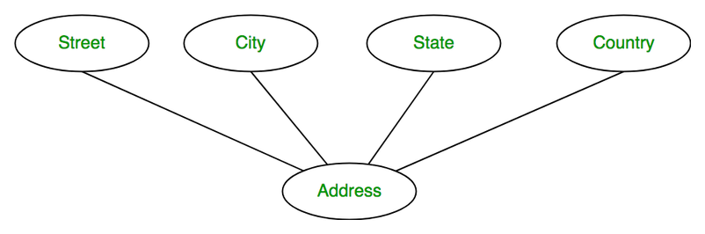
Entity Relationship Data Model
2. Composite Attribute
An attribute composed of many other attributes is called a composite attribute. For example, the Address attribute of the student Entity type consists of Street, City, State, and Country. In ER diagram, the composite attribute is represented by an oval comprising of ovals.
Composite Attribute

Slide 23
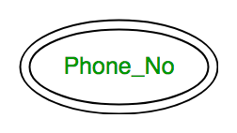
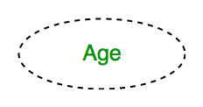
Entity Relationship Data Model
3. Multivalued Attribute:
An attribute consisting of more than one value for a given entity. For example, Phone_No (can be more than one for a given student). In ER diagram, a multivalued attribute is represented by a double oval.
4. Derived Attribute:
An attribute that can be derived from other attributes of the entity type is known as a derived attribute. e.g.; Age (can be derived from DOB). In ER diagram, the derived attribute is represented by a dashed oval.
Multivalued Attribute
Derived Attribute

Slide 24
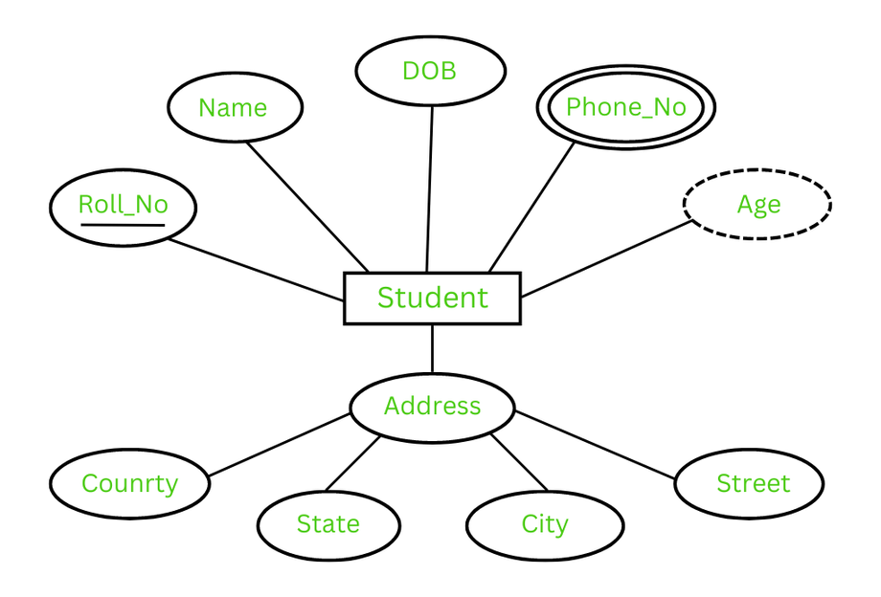
Entity Relationship Data Model

Slide 25
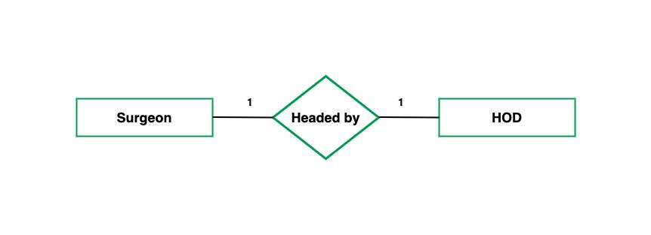
Entity Relationship Data Model
What is Cardinality?
The number of times an entity of an entity set participates in a relationship set is known as cardinality. Cardinality can be of different types:
1. One-to-One: When each entity in each entity set can take part only once in the relationship, the cardinality is one-to-one. Let us assume that a male can marry one female, and a female can marry one male. So the relationship will be one-to-one.
one to one cardinality

Slide 26
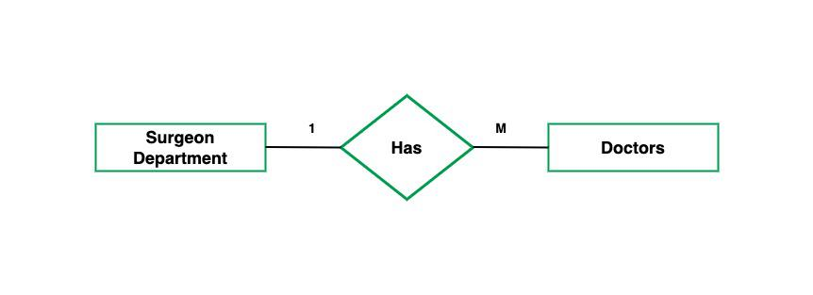
Entity Relationship Data Model
2. One-to-Many: In one-to-many mapping as well where each entity can be related to more than one entity and the total number of tables that can be used in this is 2. Let us assume that one surgeon department can accommodate many doctors. So the Cardinality will be 1 to M. It means one department has many Doctors.
one to many cardinality

Slide 27
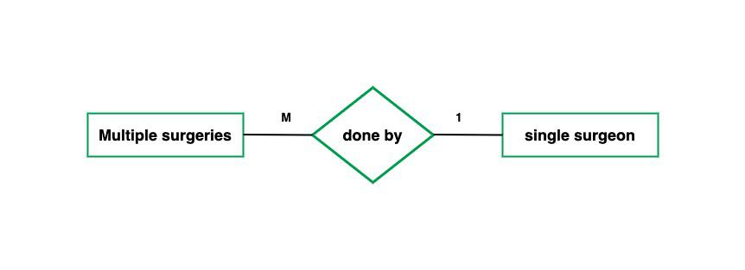
Entity Relationship Data Model
3. Many-to-One: When entities in one entity set can take part only once in the relationship set and entities in other entity sets can take part more than once in the relationship set, cardinality is many to one. Let us assume that a student can take only one course but one course can be taken by many students. So the cardinality will be n to 1. It means that for one course there can be n students but for one student, there will be only one course. The total number of tables that can be used in this is 3.
many to one cardinality

Slide 28
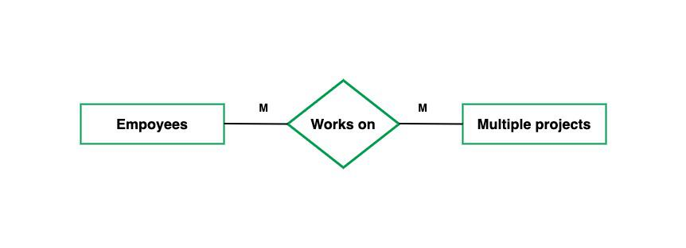
Entity Relationship Data Model
4. Many-to-Many: When entities in all entity sets can take part more than once in the relationship cardinality is many to many. Let us assume that a student can take more than one course and one course can be taken by many students. So the relationship will be many to many. The total number of tables that can be used in this is 3.
many to many cardinality

Slide 29
Entity Relationship Data Model
ER Diagram stands for Entity Relationship Diagram, also known as ERD is a diagram that displays the relationship of entity sets stored in a database. In other words, ER diagrams help to explain the logical structure of databases. ER diagrams are created based on three basic concepts: entities, attributes and relationships.
Why Use ER Diagrams In DBMS?
ER diagrams represent the E-R model in a database, making them easy to convert into relations (tables).
ER diagrams provide the purpose of real-world modeling of objects which makes them intently useful.
ER diagrams require no technical knowledge and no hardware support.
These diagrams are very easy to understand and easy to create even for a naive user.
It gives a standard solution for visualizing the data logically.

Slide 30
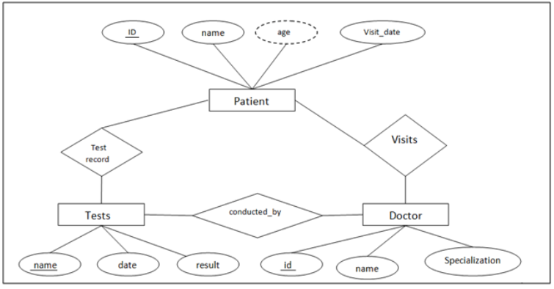
Hospital management system
Each of these entities have their respective attributes which are −
Patients - ID (primary key), name, age,visit_date
Tests- Name (primary key), date, result
Doctor- ID (primary key), name, specialisation

Slide 31
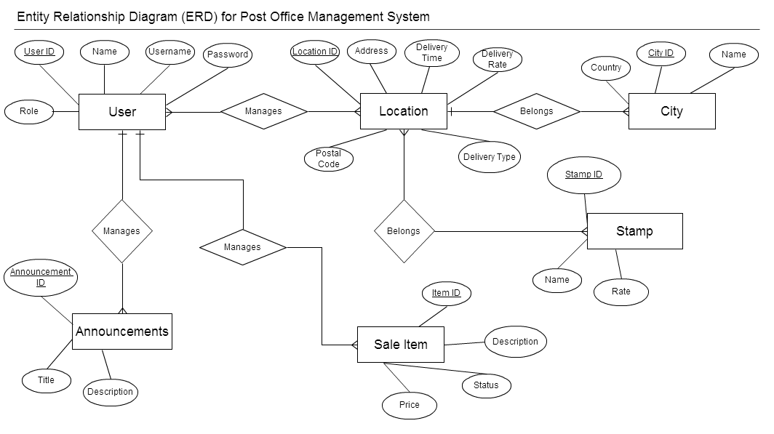
Post Office Management System

Slide 32
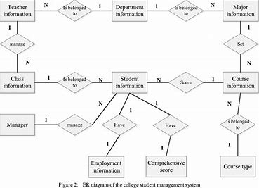
Student Management System

Slide 33
Constraints of Relational Database Model
On modeling the design of the relational database, we can put some restrictions like what values are allowed to be inserted in the relation, what kind of modifications and deletions are allowed in the relation. These are the restrictions we impose on the relational database. This facility of restriction was not available in the ER Model.
The main restrictions are of four types-
Domain Constraints
Key Constraints
Entity Integrity Constraints
Referential Integrity Constraints

Slide 34
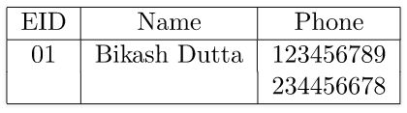
Domain Constraints
Every domain must contain atomic values(smallest indivisible units) it means composite and multi-valued attributes are not allowed.
We perform datatype check here, which means when we assign a data type to a column, we limit the values that it can contain. E.g. If we assign the datatype of attribute age as int, we can't give it values other then int datatype.
Explanation: In the above relation, Name is a composite attribute and Phone is a multi-values attribute, so it is violating domain constraint.

Slide 35
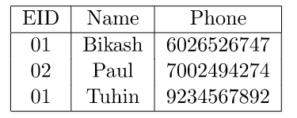
Key Constraints or Uniqueness Constraints
These are called uniqueness constraints since it ensures that every tuple in the relation should be unique.
A relation can have multiple keys or candidate keys(minimal super key), out of which we choose one of the keys as primary key, we don’t have any restriction on choosing the primary key out of candidate keys, but it is suggested to go with the candidate key with a smaller number of attributes.
Null values are not allowed in the primary key, hence Not Null constraint is also a part of key constraint.
Explanation:
In the above table, EID is the primary key, and first and the last tuple has the same value in EID i.e. 01, so it is violating the key constraint.

Slide 36
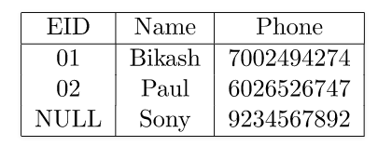
Entity Integrity Constraints
Entity Integrity constraints says that no primary key can take NULL value, since using primary key we identify each tuple uniquely in a relation.
Explanation: In the above relation, EID is made primary key, and the primary key cant take NULL values but in the third tuple, the primary key is null, so it is a violating Entity Integrity constraints.

Slide 37
Referential Integrity Constraints
The Referential integrity constraints is specified between two relations or tables and used to maintain the consistency among the tuples in two relations.
This constraint is enforced through foreign key, when an attribute in the foreign key of relation R1 have the same domain(s) as the primary key of relation R2, then the foreign key of R1 is said to reference or refer to the primary key of relation R2.
The values of the foreign key in a tuple of relation R1 can either take the values of the primary key for some tuple in relation R2, or can take NULL values, but can’t be empty.

Slide 38
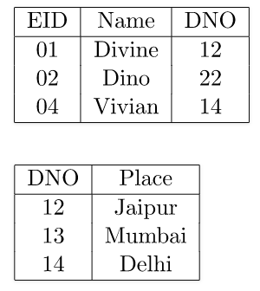
Explanation:
In the table, DNO of the first relation is the foreign key, and DNO in the second relation is the primary key. DNO = 22 in the foreign key of the first table is not allowed since DNO = 22 is not defined in the primary key of the second relation. Therefore, Referential integrity constraints is violated here

Slide 39
Relationship Types
Specialization
Generalization
Aggregation

Slide 40
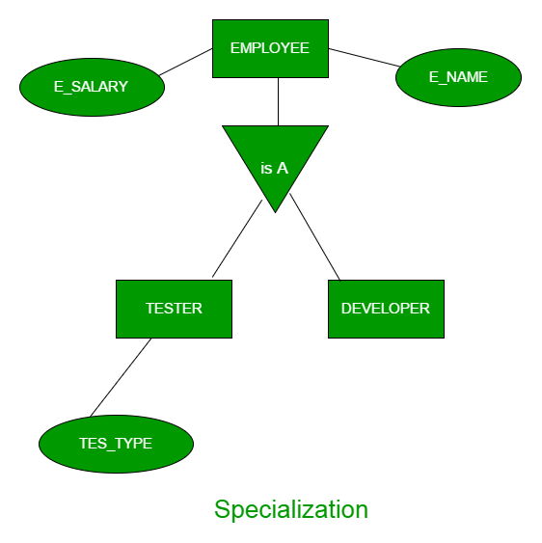
Specialization
In specialization, an entity is divided into sub-entities based on their characteristics. It is a top-down approach where higher level entity is specialized into two or more lower-level entities.
For Example, EMPLOYEE entity in an Employee management system can be specialized into DEVELOPER, TESTER etc. as shown in Figure 2. In this case, common attributes like E_NAME, E_SAL etc. become part of higher entity (EMPLOYEE) and specialized attributes like TES_TYPE become part of specialized entity (TESTER).

Slide 41
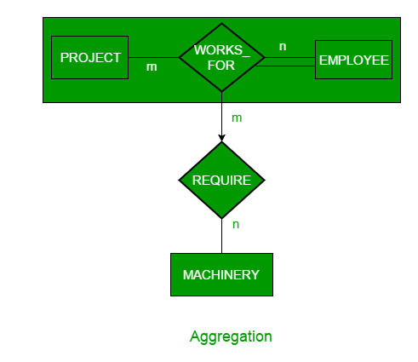
Aggregation
An ER diagram is not capable of representing relationship between an entity and a relationship which may be required in some scenarios. In those cases, a relationship with its corresponding entities is aggregated into a higher-level entity.
For Example, Employee working for a project may require some machinery. So, REQUIRE relationship is needed between relationship WORKS_FOR and entity MACHINERY. Using aggregation, WORKS_FOR relationship with its entities EMPLOYEE and PROJECT is aggregated into single entity and relationship REQUIRE is created between aggregated entity and MACHINERY.

Slide 42
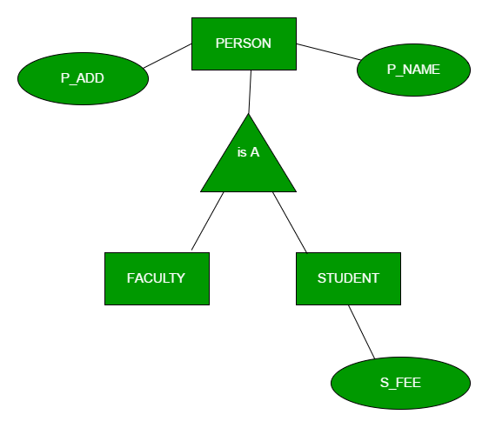
Generalization
Generalization is the process of extracting common properties from a set of entities and create a generalized entity from it. It is a bottom-up approach in which two or more entities can be generalized to a higher-level entity if they have some attributes in common.
For Example,
STUDENT and FACULTY can be generalized to a higher-level entity called PERSON as shown in Figure 1. In this case, common attributes like P_NAME, P_ADD become part of higher entity (PERSON) and specialized attributes like S_FEE become part of specialized entity (STUDENT).

Slide 43
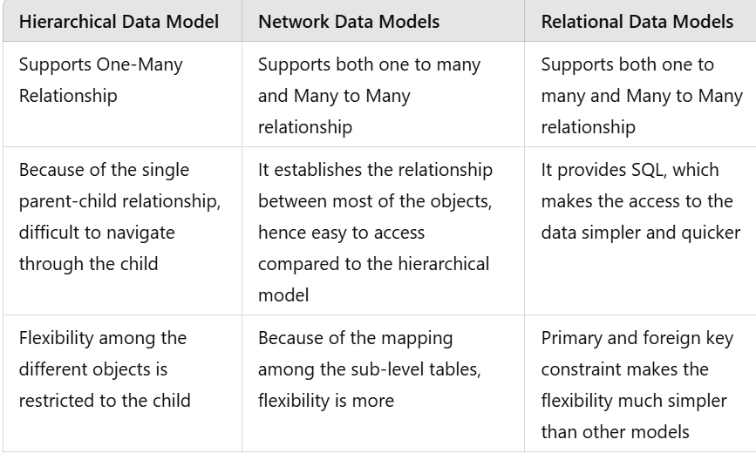
Comparison of Models

Slide 44
PRACTICE PROBLEMS BASED ON CONVERTING ER DIAGRAM TO TABLES

Slide 45
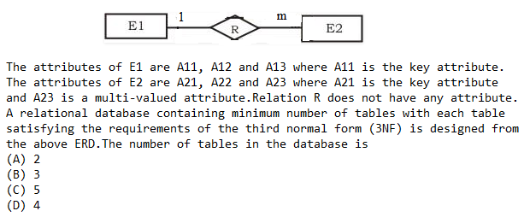
Example 1
Consider the following entity relationship diagram (ERD), where two entities E1 and E2 have a relation R of cardinality 1 : m.

Slide 46
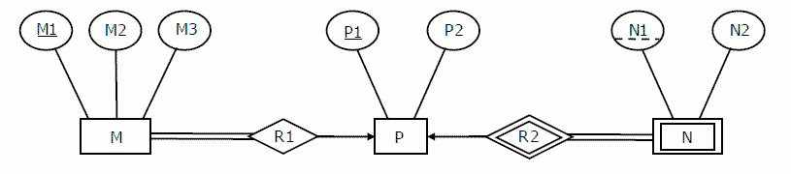
EXAMPLE 2
Consider the following ER diagram in relational model-
The minimum number of tables needed to represent M, N, P, R1, R2 is (A) 2 (B) 3 (C) 4 (D) 5

Slide 47
Consider the following ER diagram in relational model-
Applying the rules, minimum 3 tables will be required-
MR1 (M1 , M2 , M3 , P1)
P (P1 , P2)
NR2 (P1 , N1 , N2)

Slide 48
EXAMPLE 3
Let E1 and E2 be two entities in an ER diagram with simple single-valued attributes. R1 and R2 are two relationships between E1 and E2, where R1 is one-to-many and R2 is many-to-many. R1 and R2 do not have any attributes of their own. What is the minimum number of tables required to represent this situation in the relational model?
(a) 2 (b) 3 (c) 4 (d) 5

Slide 49
Let E1 and E2 be two entities in an ER diagram with simple single-valued attributes. R1 and R2 are two relationships between E1 and E2, where R1 is one-to-many and R2 is many-to-many. R1 and R2 do not have any attributes of their own. What is the minimum number of tables required to represent this situation in the relational model?
(a) 2 (b) 3 (c) 4 (d) 5

Slide 50
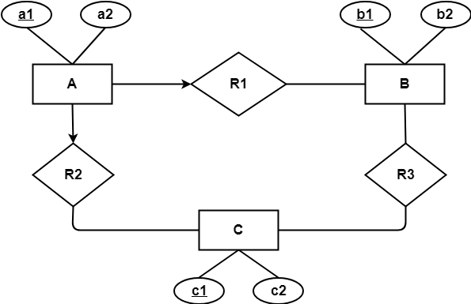
EXAMPLE 4
Find the minimum number of tables required to represent the given ER diagram in relational model-

Slide 51
Find the minimum number of tables required to represent the given ER diagram in relational model-
Minimum 4 tables will be required-
AR1R2 (a1 , a2 , b1 , c1)
B (b1 , b2)
C (c1 , c2)
R3 (b1 , c1)

Slide 52
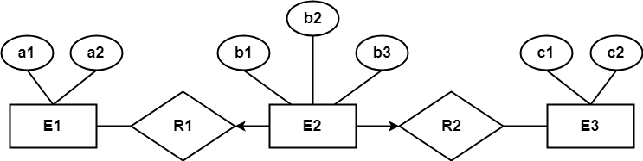
EXAMPLE 5
Find the minimum number of tables required to represent the given ER diagram in relational model-

Slide 53
Find the minimum number of tables required to represent the given ER diagram in relational model-
Applying the rules, minimum 3 tables will be required-
E1 (a1 , a2)
E2R1R2 (b1 , b2 , a1 , c1 , b3)
E3 (c1 , c2)

Slide 54
THANK YOU

